Slide 1
Culture, Body, Self
“This chapter presents a wide variety of work that asks who the ‘I’ is at the intersection of social forces and layered histories at the end of the twentieth century, and turns to the body to find an answer.”
Peter Kalb, p. 171

Slide 2
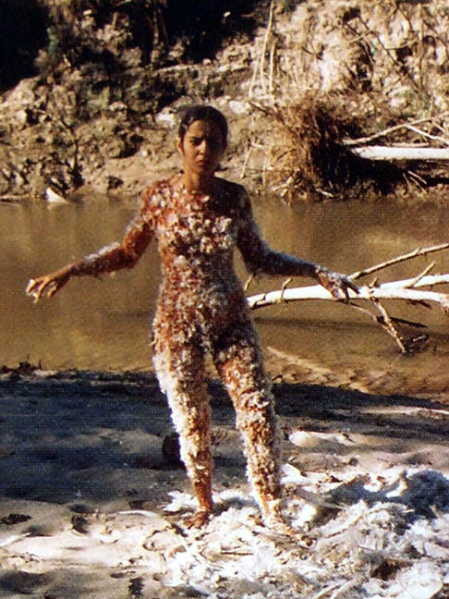
"I am overwhelmed by the feeling of having been cast from the womb (nature). My art is the way I re-establish the bonds that unite me to the universe."
- Ana Mendieta
Ana Mendieta (Cuban-American, 1948-1985) Untitled (Blood & Feathers),1974

Slide 3
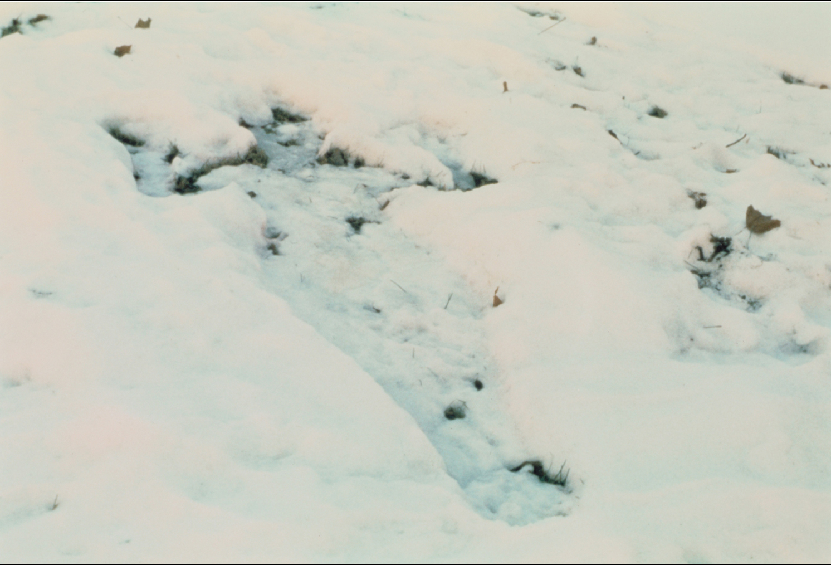
Ana Mendieta, Untitled, from the Silueta (Silhouette) series, 1977
color photograph, 10 x 8" (Series extended from 1973 to 1980
This is an “earth/body” work: both body art and earth work.

Slide 4
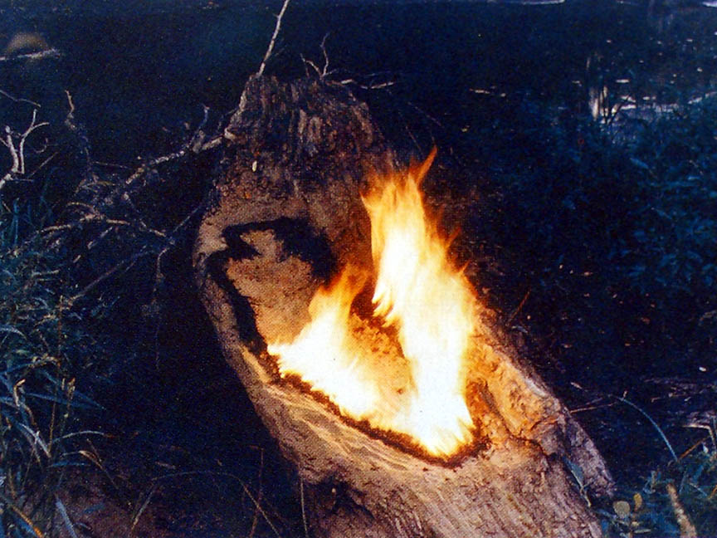
"Through my earth/body sculptures, I become one with the earth ... I become an extension of nature and nature becomes an extension of my body.”
Mendieta, Silueta, 1979

Slide 5
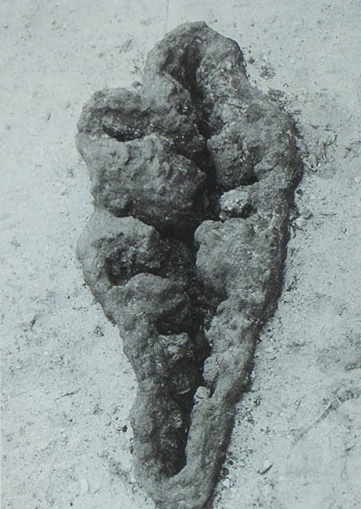
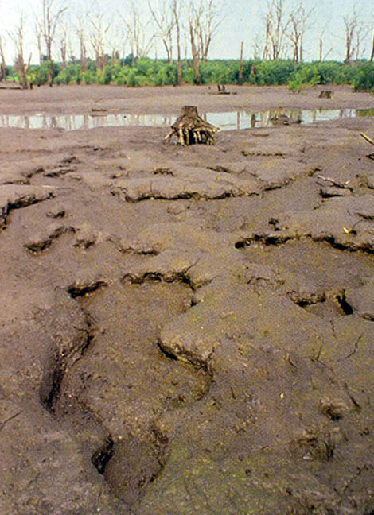
Ana Mendieta, (left) Maroya (Moon), 1982 / (right) Untitled (Silueta Series, Iowa), 1979

Slide 6
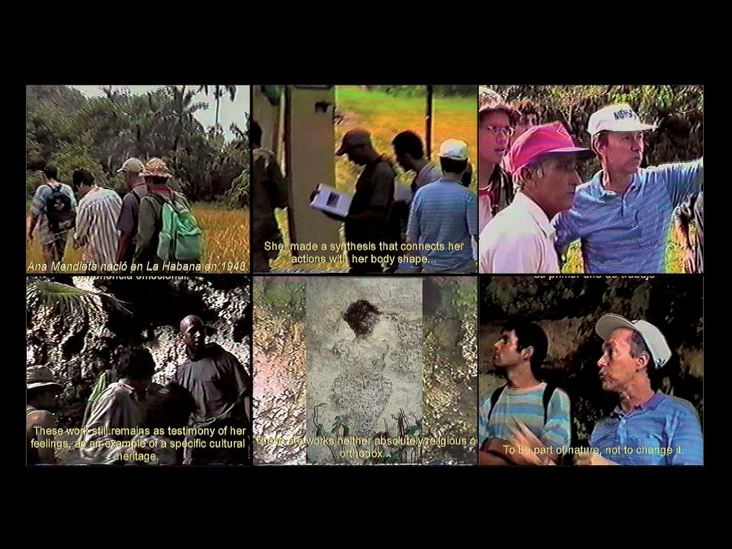
Going After a Trace: To Meet Ana Mendieta’s Cave Sculpture, 1997. Film. Courtesy Galería DUPP.

Slide 7
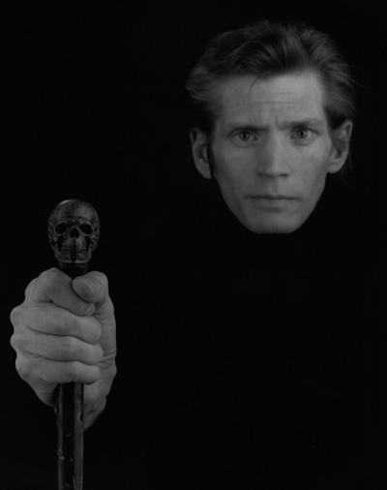
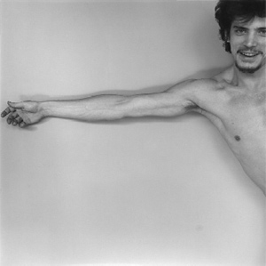
Robert Mapplethorpe (American, 1946-1989), self-portraits, 1975 and (right) 1989. His work marks the era between the Stonewall riots (June 28, 1969) and the AIDS epidemic, which began in 1981.

Slide 8
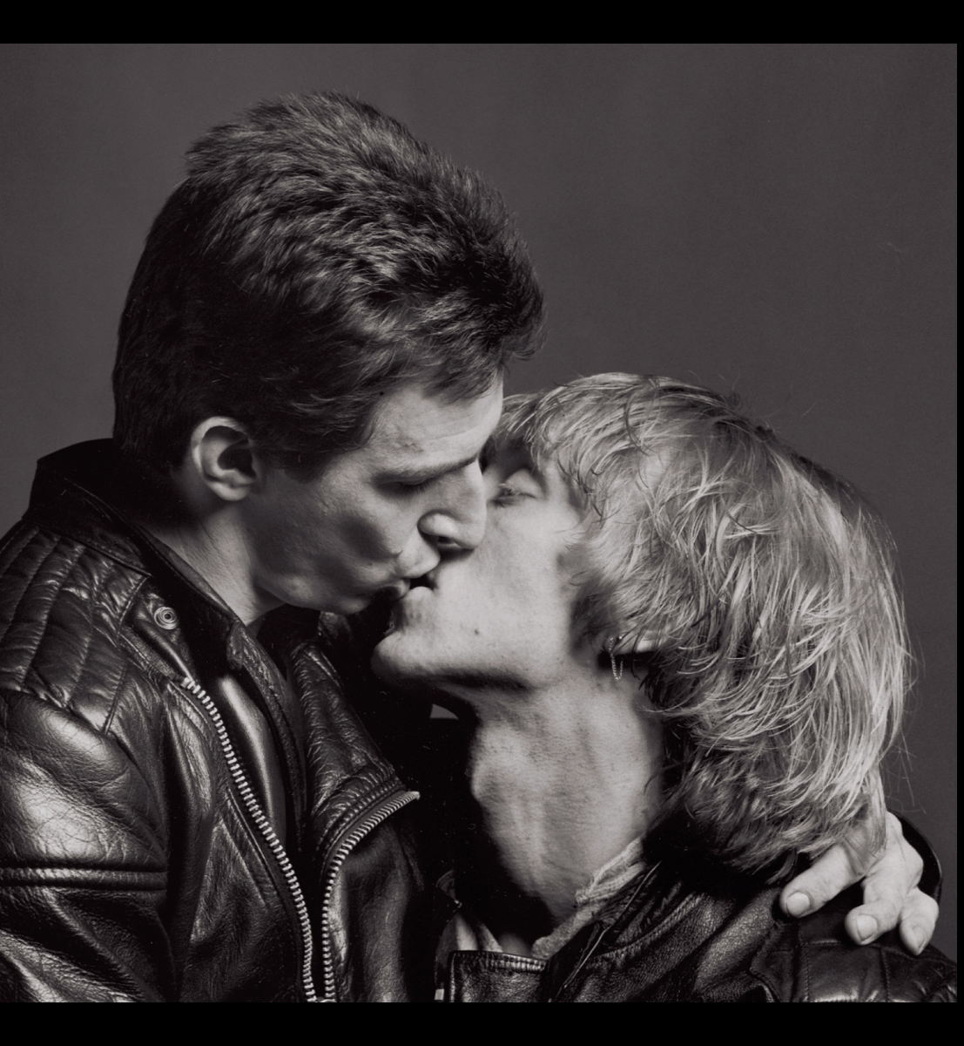
The retrospective touring exhibition in 1989-90, the year after Mapplethorpe's death, was censored by U.S. Senator Jesse Helms and others. The Corcoran closed it to avoid losing NEA funding. Protests included projections of Mapplethorpe’s photographs on the Corcoran. For more, go to: http://www.publiceye.org/theocrat/Mapplethorpe_Chrono.html
Robert Mapplethorpe, Larry and Bobby Kissing, 1979. 13 5∕8 x 13 5∕8"

Slide 9
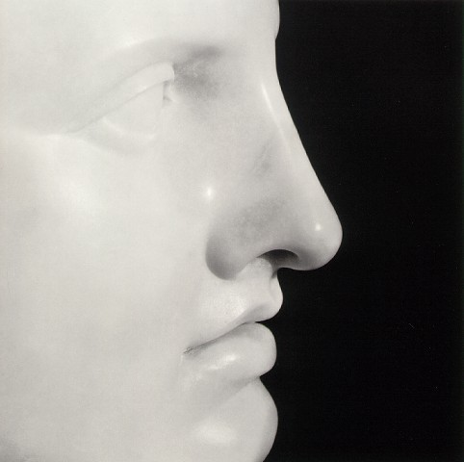
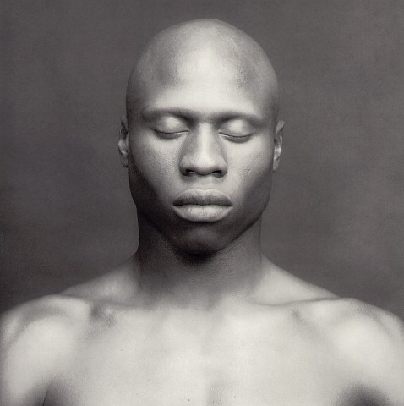
Robert Mapplethorpe, (left) Apollo, 1988; (right) Ken Moody, 1986

Slide 10
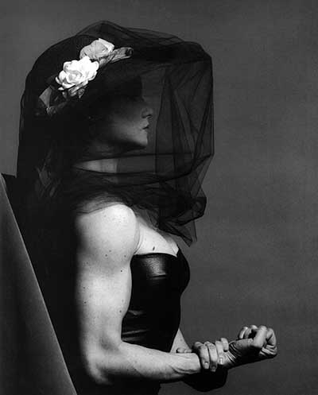
Robert Mapplethorpe Lisa Lyon, 1982 Mapplethorpe did a series of photographs of Lyon published in the book, Lady, Lisa Lyon (a cult classic) In 1980 Lisa Lyon, world’s first woman bodybuilding champion and performance artist, weighed 120 pounds, could dead-lift 225 pounds, bench-press 120 pounds, and squat 265 pounds - two and a half times her own weight

Slide 11
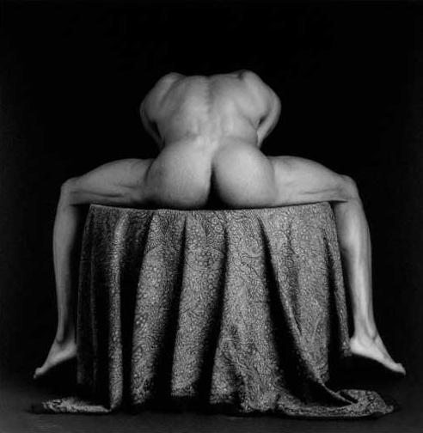
Robert Mapplethorpe, Carleton, 1987, gelatin silver print, edition 1/10, image: 19 ¼ x 19 ¼”. The retrospective touring exhibition in 1989-90, the year after Mapplethorpe's death, was censored by U.S. Senator Jesse Helms and others. The Corcoran closed it to avoid losing NEA funding. Protests included projections of Mapplethorpe’s photographs on the Corcoran. For more on the chronology of Reagan-era censorship: http://www.publiceye.org/theocrat/Mapplethorpe_Chrono.html

Slide 12
Marina Abramovic Art Must Be Beautiful, 1975

Slide 13
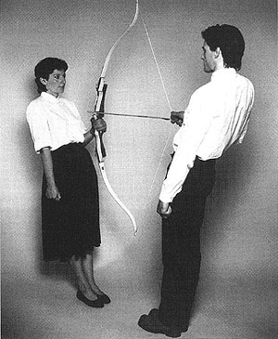
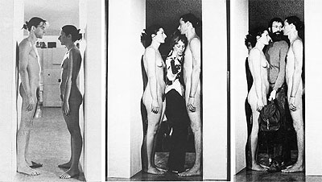
Marina Abramovic and Ulay (Uwe Laysiepen, German) (left) Rest Energy, video with audio of heartbeats, 1980 (right) Imponderabilia, performance at museum entrance, Gallery of Modern Art, Bologna, 90-minute performance, 1978.

Slide 14
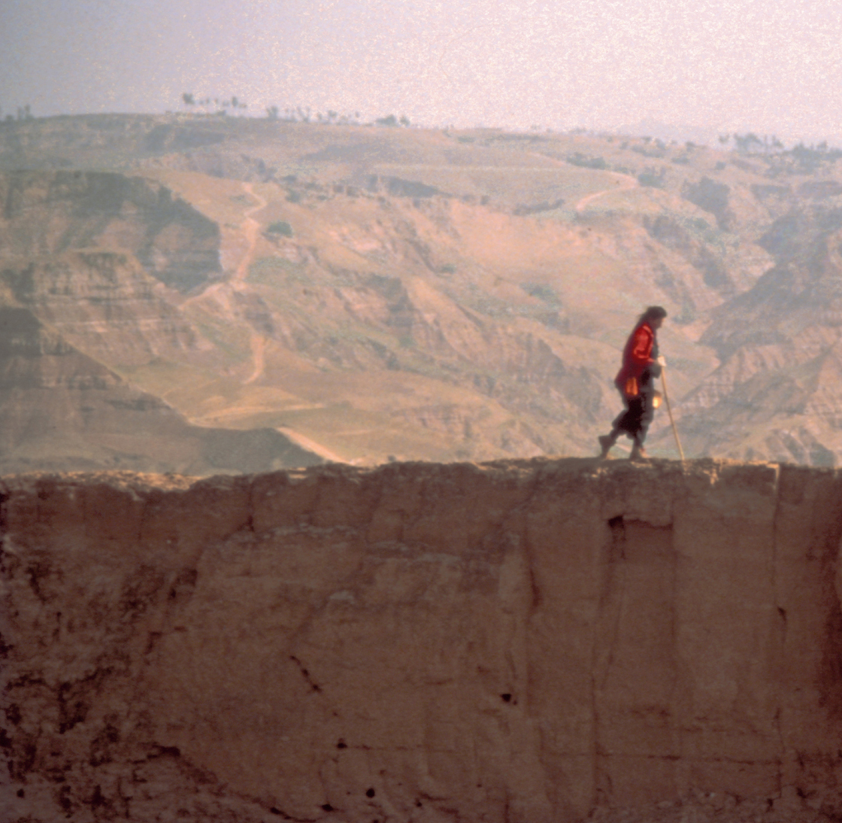
Marina Abramović and Ulay, The Lovers—The Great Wall Walk, 1988 Performance piece walking the Great Wall of China.
http://youtu.be/O6dF8Gjm-X8

Slide 15
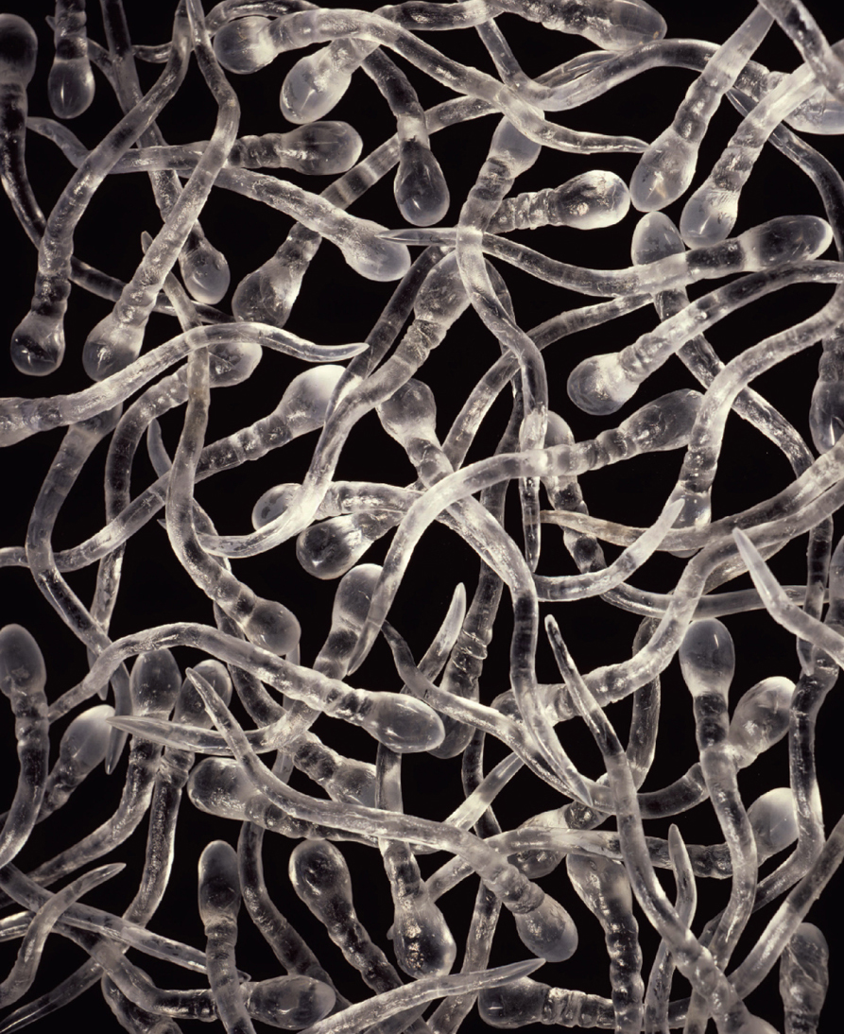
Kiki Smith, Untitled (detail) 1989–90. Glass and rubber, 3 x 108 x 108”

Slide 16
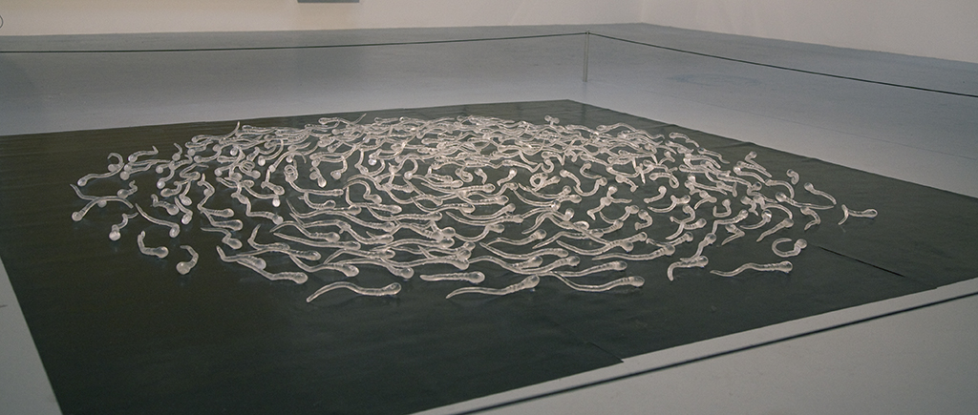

Slide 17
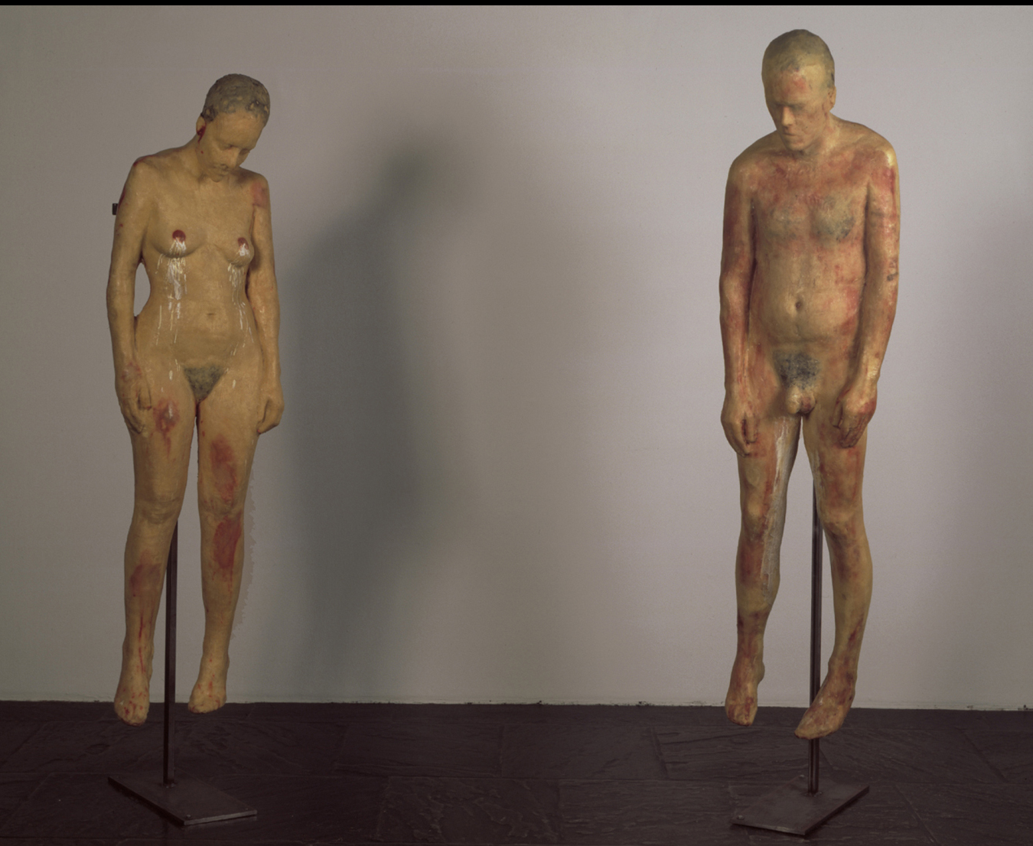
Kiki Smith, Untitled, 1990. Beeswax and microcrystalline wax figures on metal stands. Height of female figure 73 1∕2"; height of male figure 76 15∕16”
Whitney Museum of American Art, New York

Slide 18
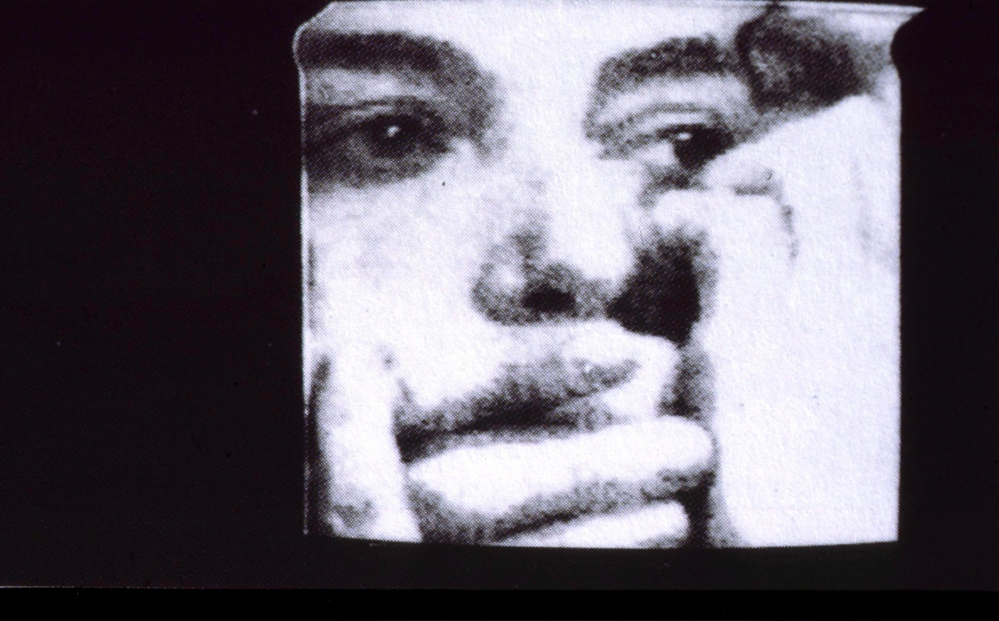
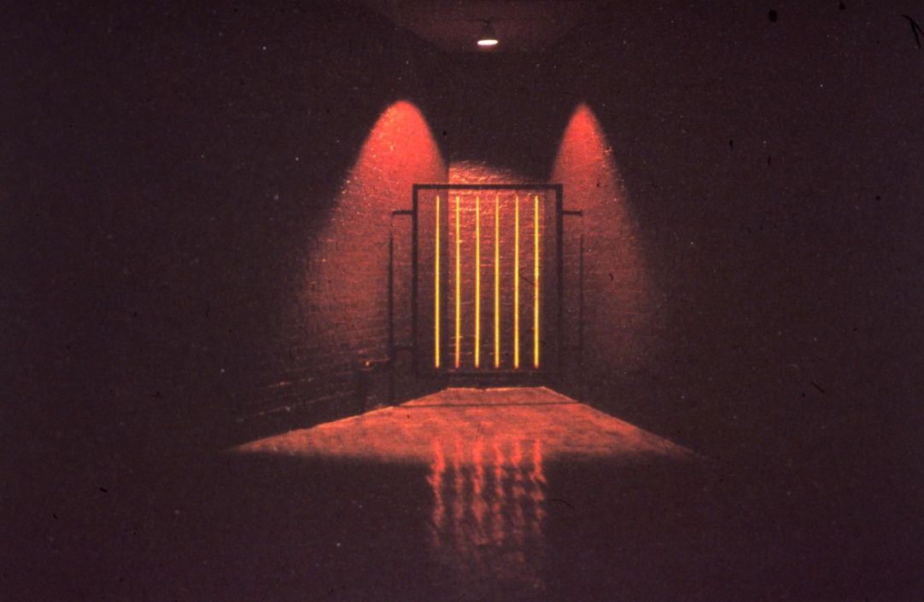
Mona Hatoum (b.1952, Beirut, Lebanon) Her Palestinian parents were exiled to Lebanon in 1948 with the establishment of the Israeli state. During a visit to London in 1975, civil war broke out in Lebanon and Hatoum was forced to stay in London. Hatoum has a British passport, identifies as Palestinian and is based in London.
(right) video still from So Much I Want to Say, 1983
“I was completely taken in by Minimal and Conceptual Art when I was on my first degree course. Going to University afterwards …. when I got into the area of installation and object making, I wouldn't say I went back to a minimal aesthetic as such, it was more a kind of reductive approach.”
Hatoum, Light at the End, 1989, London,
iron frame and six electric heating elements

Slide 19
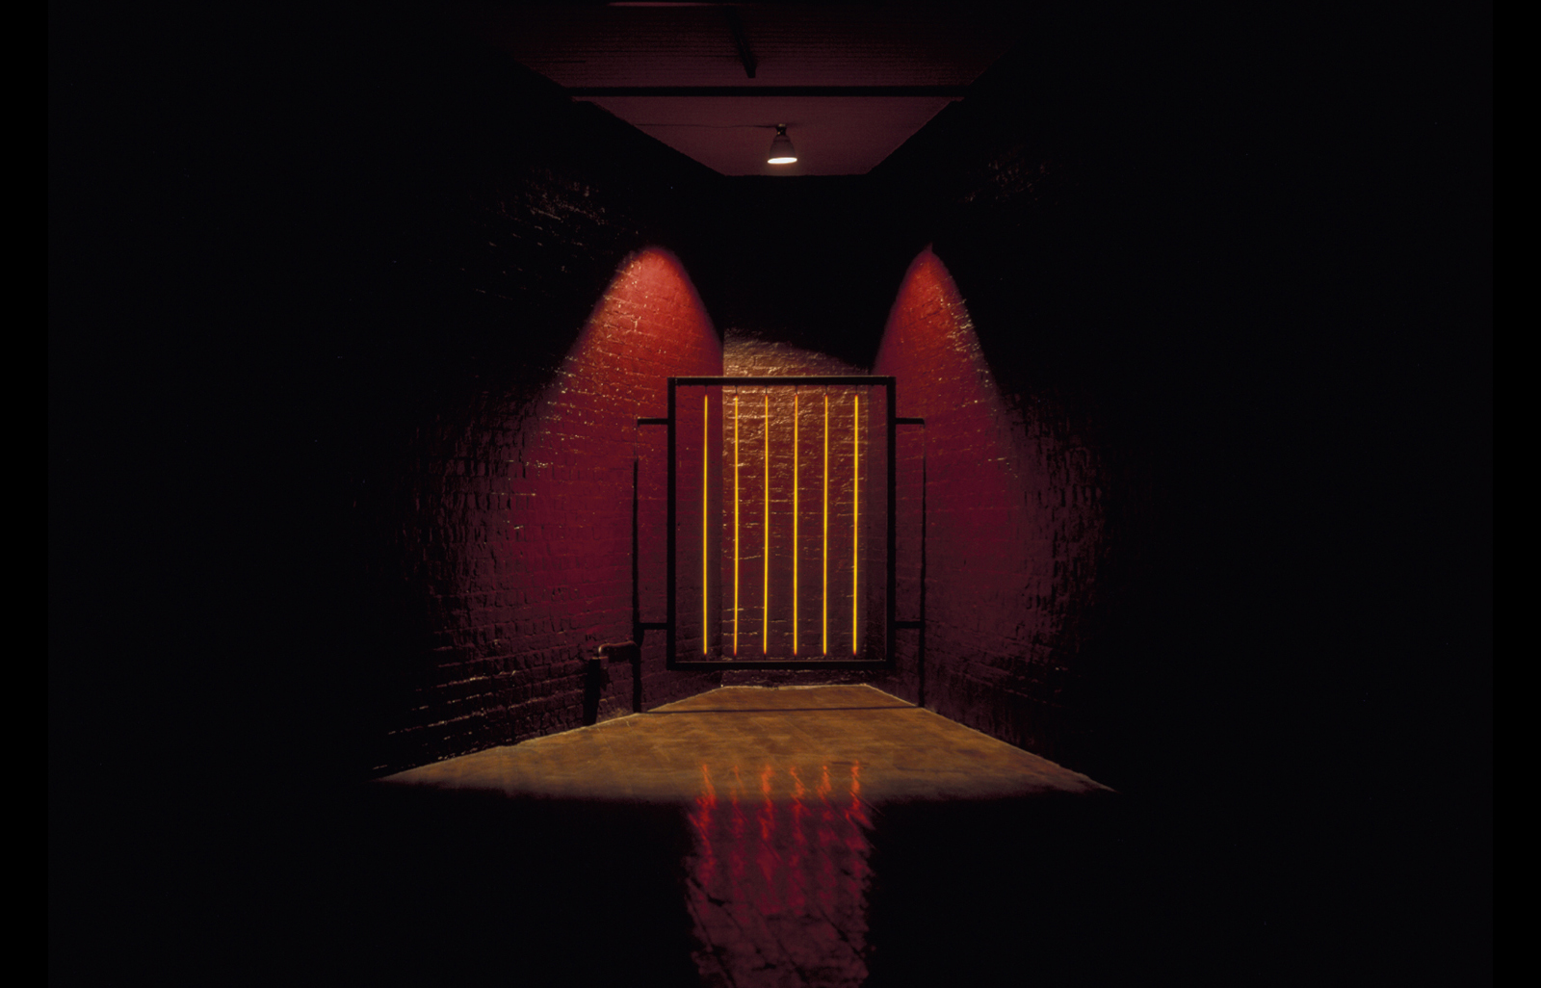
Mona Hatoum, The Light at the End, 1989. Angle iron frame and six electric heating elements, 65 3∕8 x 63 15∕16 x 1 15∕16"

Slide 20
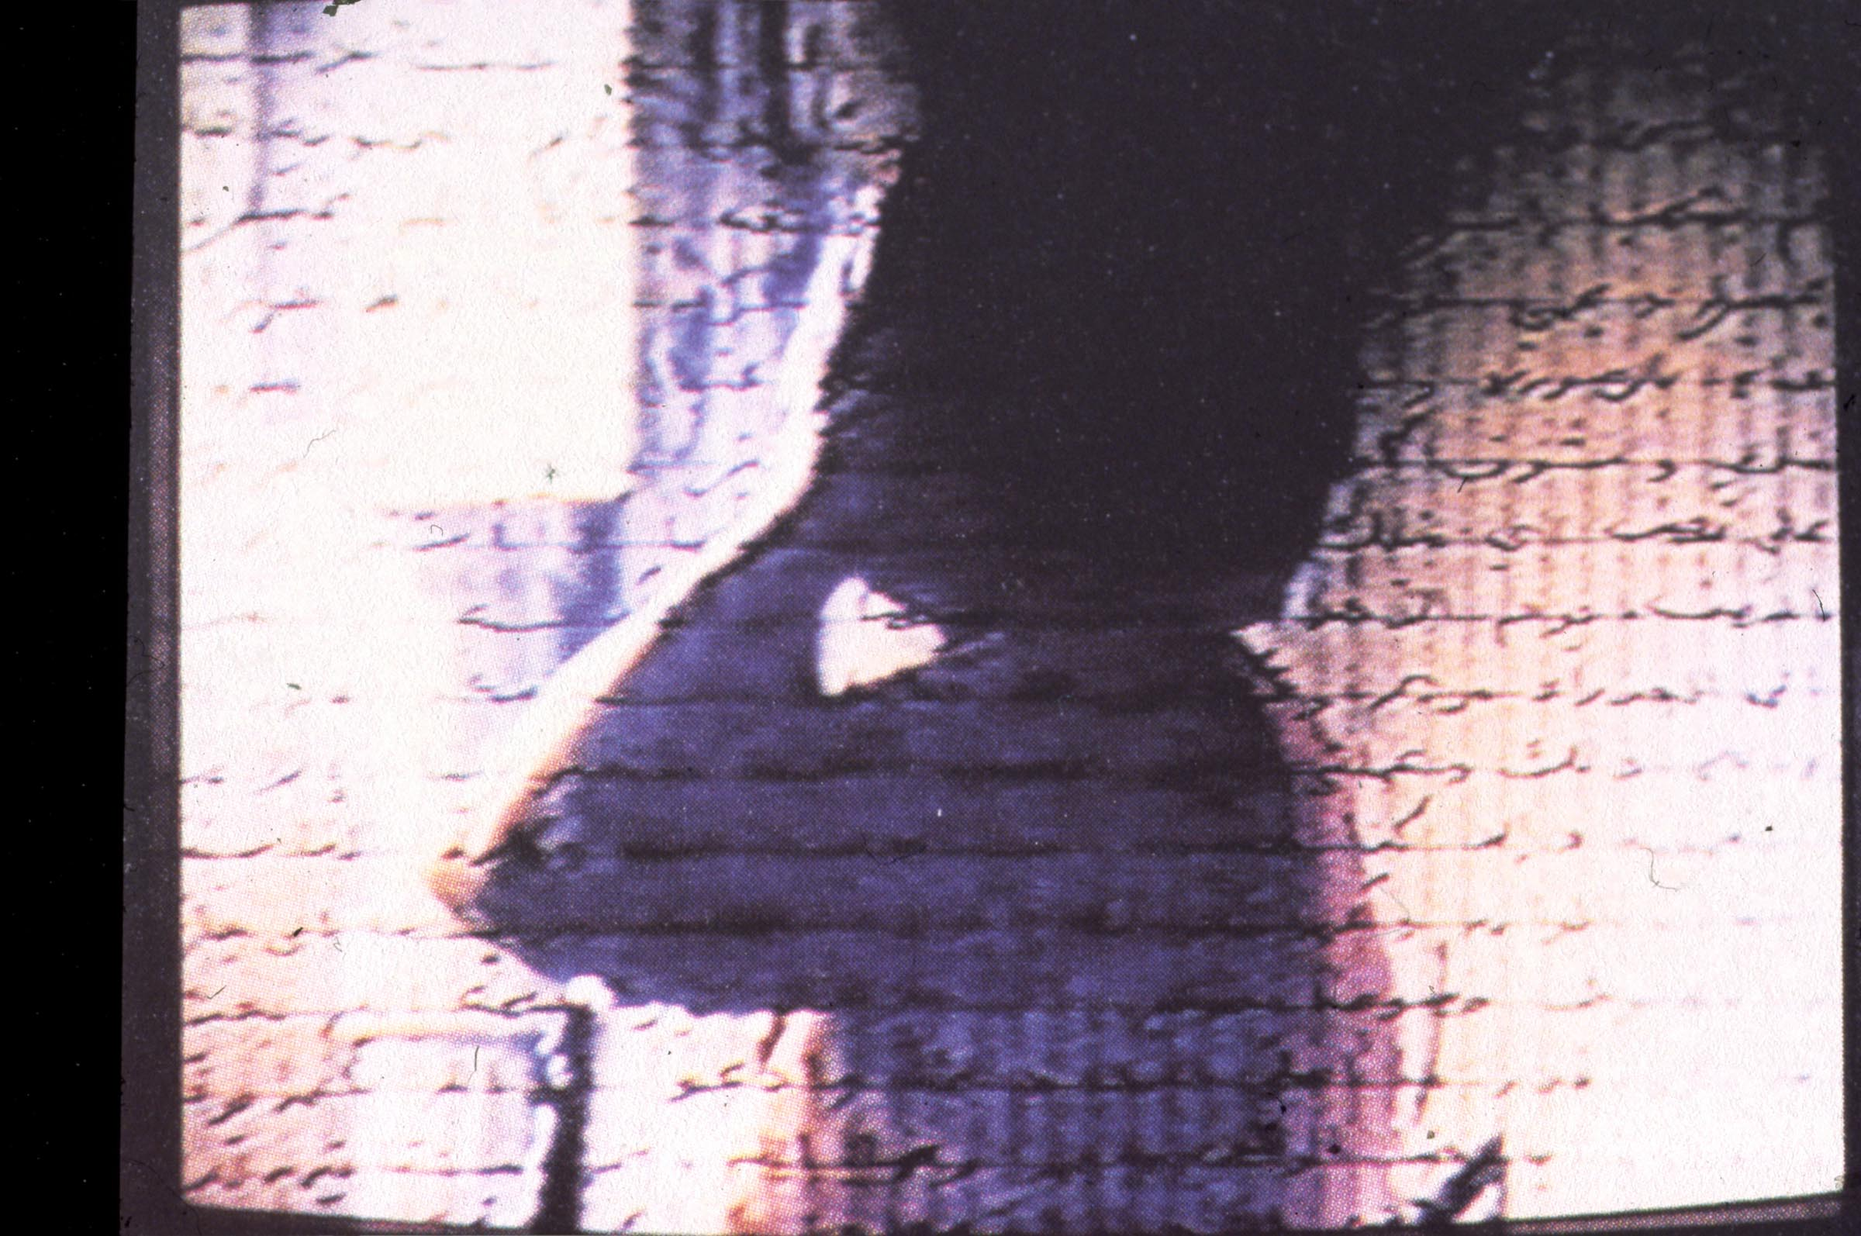
Mona Hatoum, still from Measures of Distance, 15-minute video, 1988. Letters written by Hatoum's mother in Beirut to her daughter in London appear as Arabic text moving over the screen and are read aloud in English by Hatoum.

Slide 21
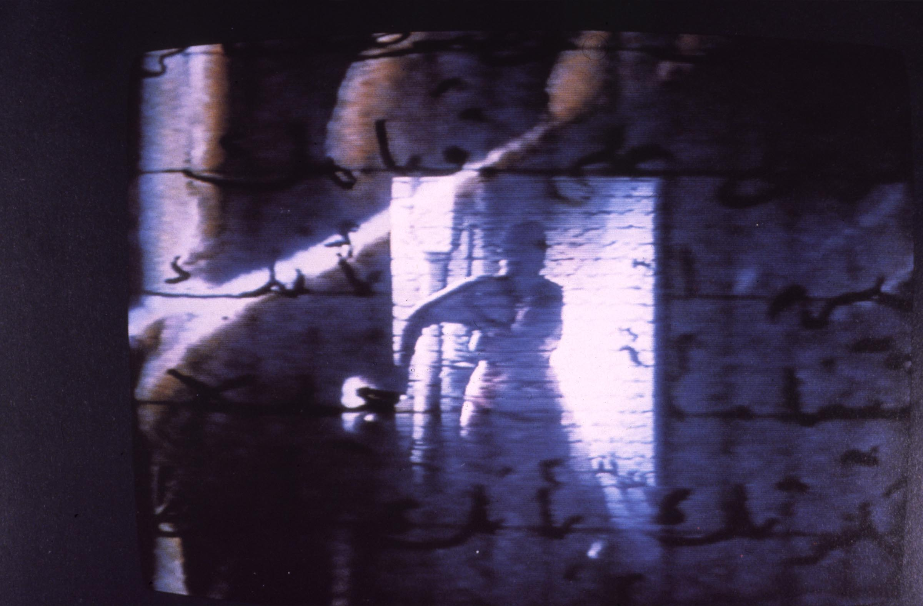
On a visit to Lebanon, Hatoum filmed her mother in the shower. She taped her mother talking to her about her own feelings, her sexuality, her husband’s objections to Hatoum’s art, including this film.

Slide 22
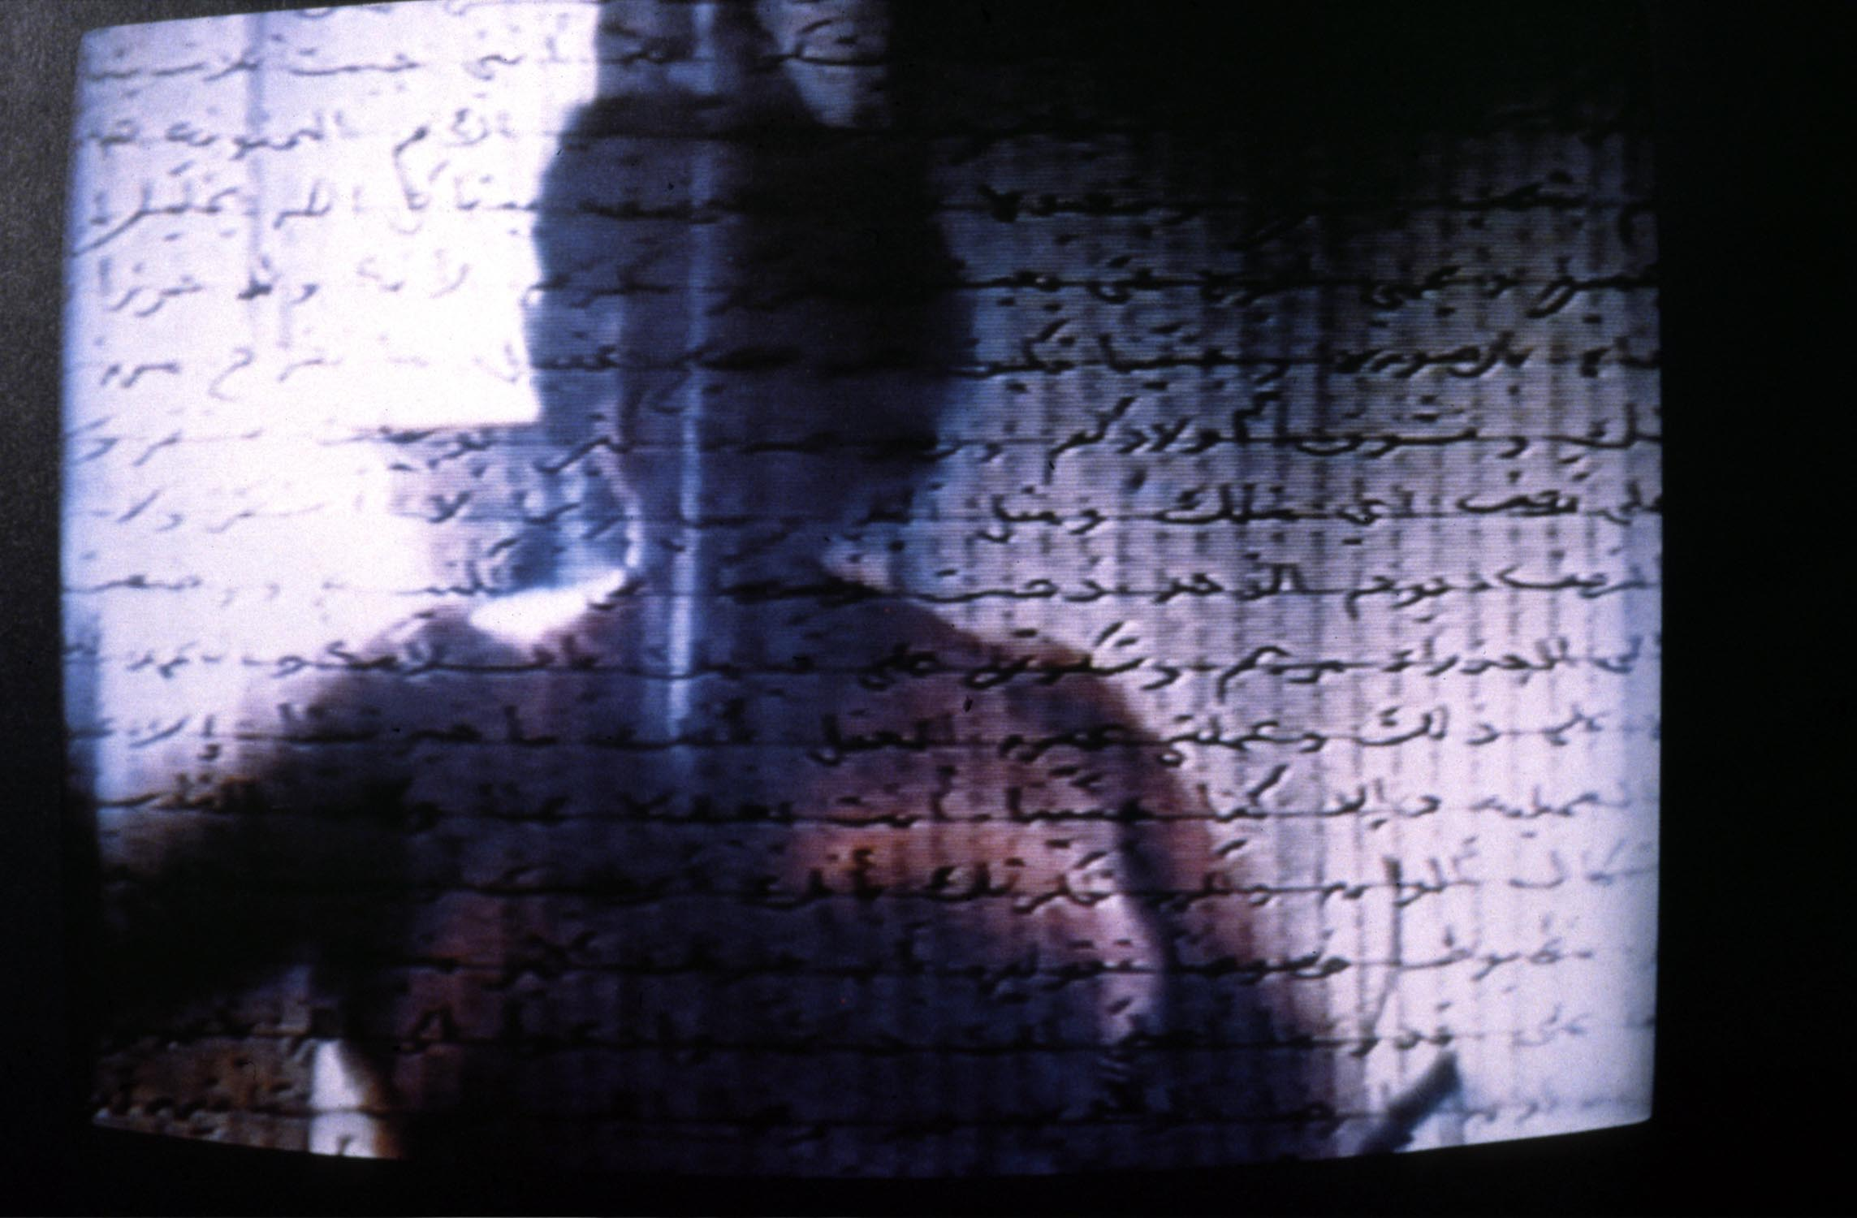

Slide 23
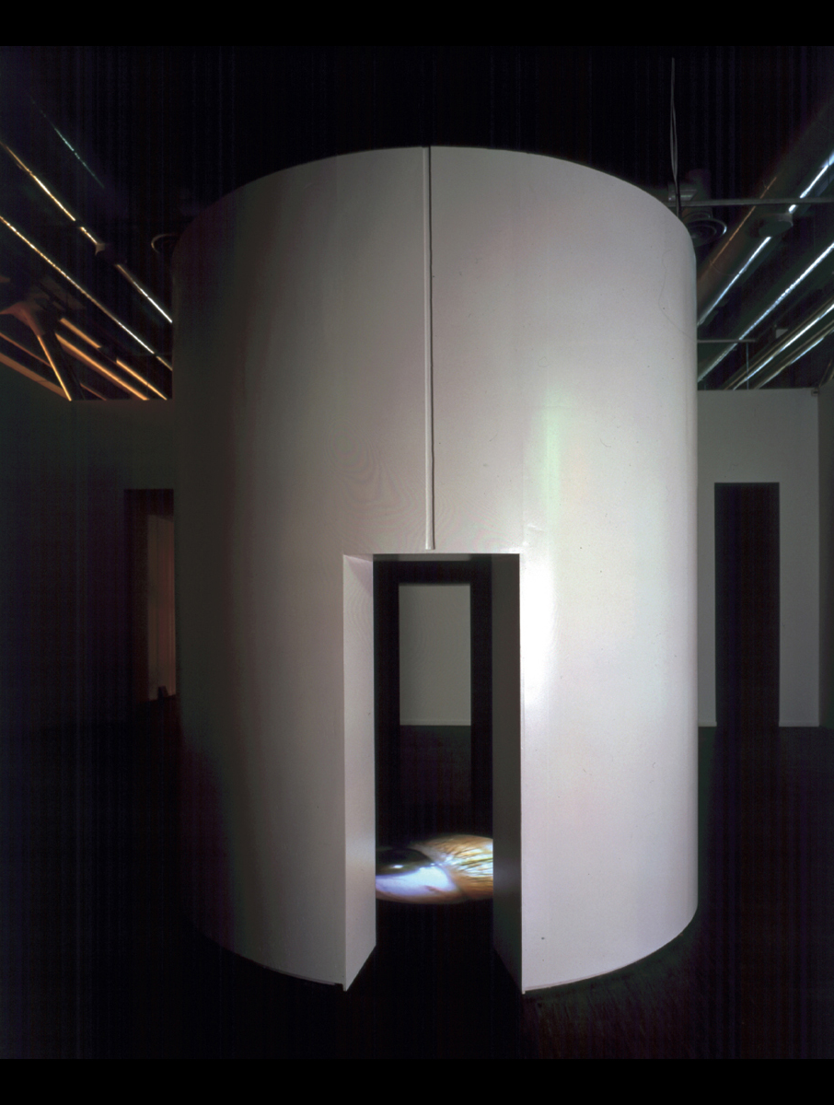
Mona Hatoum, Corps étranger (Foreign body), 1994. Video installation with cylindrical wooden structure, video projector, video player, amplifier and four speakers, 137 13∕16 x 118 1∕8 x 118 1∕8" Centre Pompidou, Paris

Slide 24
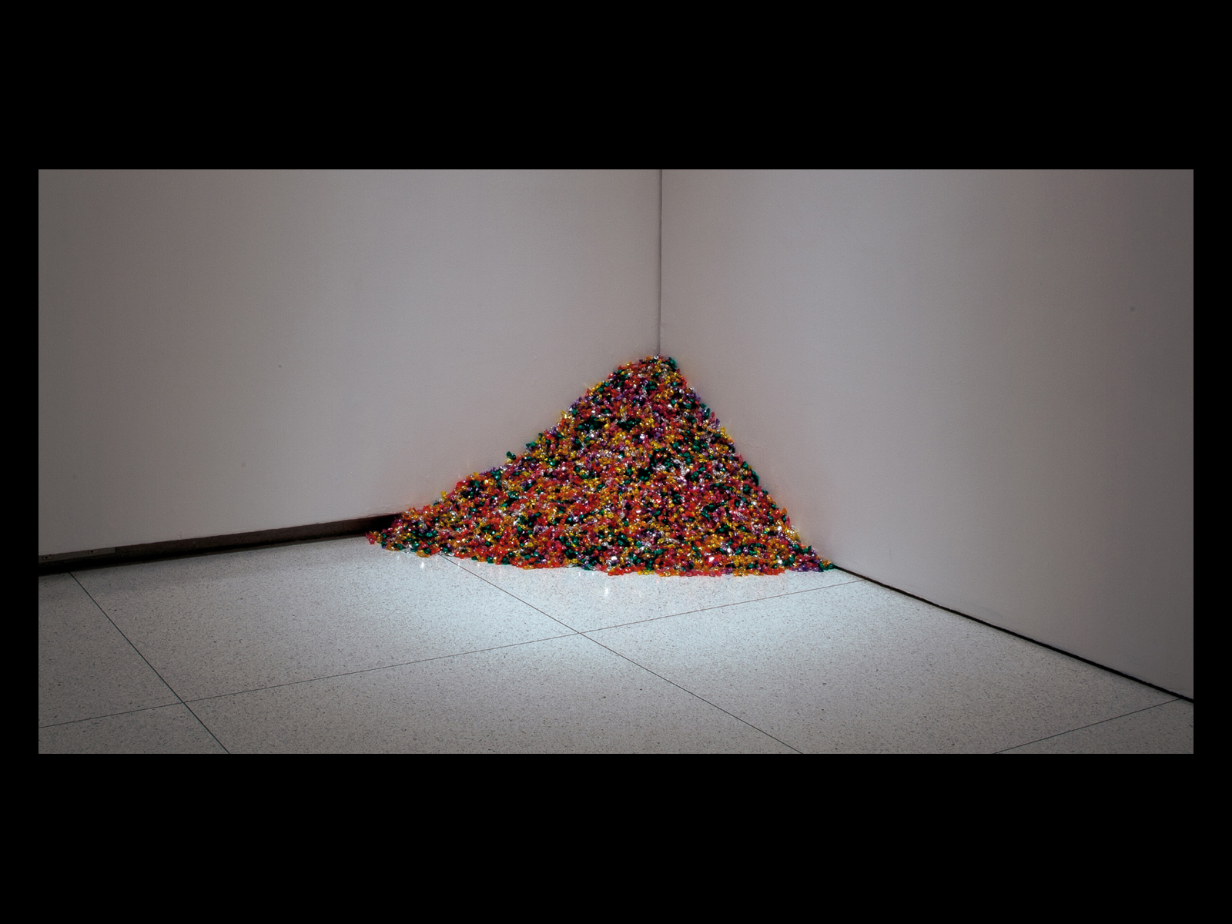
Felix Gonzalez-Torres, “Untitled” (Portrait of Ross in LA), 1991. Candies individually wrapped in multicolored cellophane, endless supply. Overall dimensions vary with installation. Ideal weight 175 lbs

Slide 25
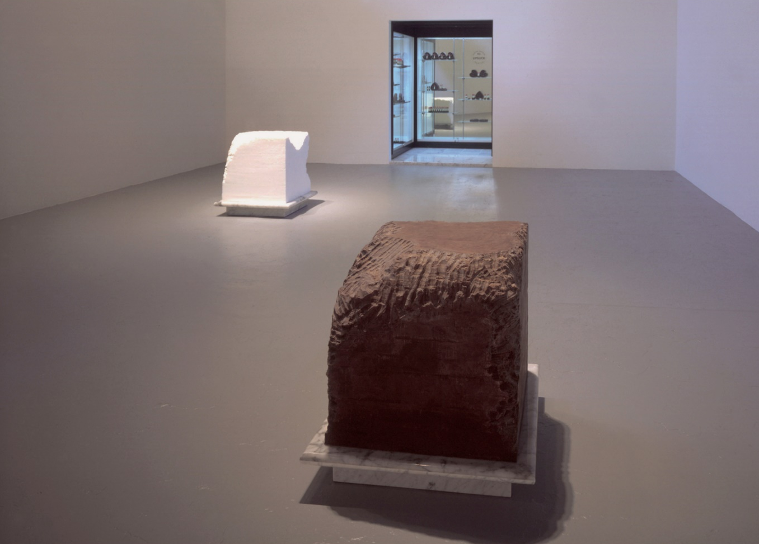
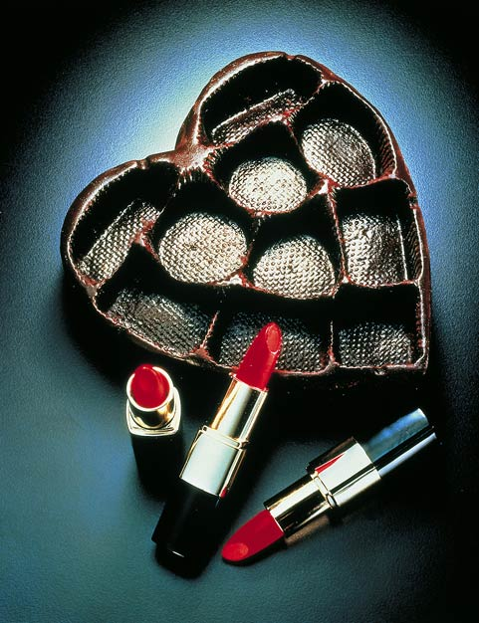
Janine Antoni, Gnaw, 1992, Three part installation. Chocolate: 600 lbs. of chocolate gnawed by the artist; lard: 600 lbs. of lard gnawed by the artist; display: 130 Lipsticks made with pigment, beeswax, and chewed lard removed from the lard cube; 27 Heart-shaped packages made from chewed chocolate removed from the chocolate cube. MOCA Los Angeles
"With Gnaw I was thinking about traditional sculpture, about carving. I was also interested in figurative sculpture. I put those two ideas together and decided that rather than describing the body, I would use the body, my body, as a tool for making art.“
- Antoni

Slide 26
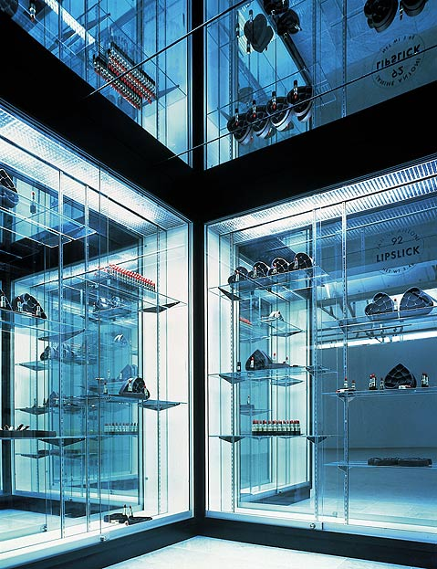
Janine Antoni, Gnaw, installation

Slide 27
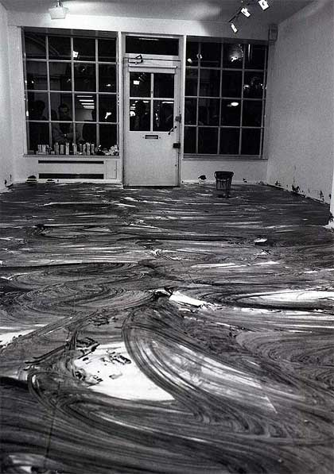
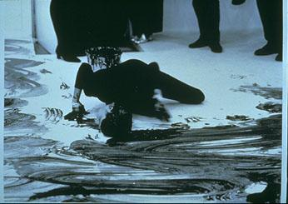
Janine Antoni, Loving Care, 1993, Installation view at Anthony D'Offay Gallery, London. The artist soaked her hair in hair dye and mopped the floor with it.
I mopped the floor with my hair…The reason I’m so interested in taking my body to those extreme places is that that’s a place where I learn, where I feel most in my body. I’m really interested in the repetition, the discipline, and what happens to me psychologically when I put my body to that extreme place.”
— Janine Antoni

Slide 28
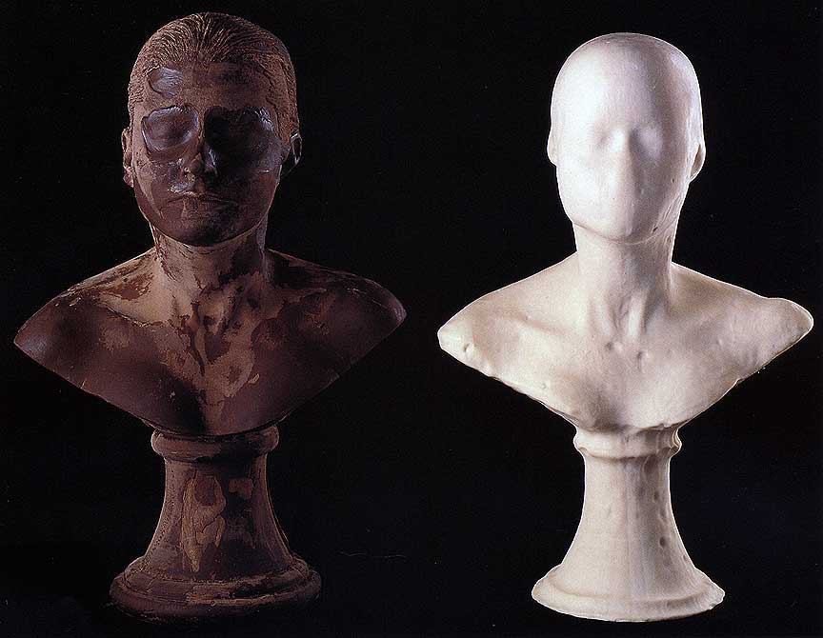
Janine Antoni, Lick and Lather, 1993, 7 soap and 7 chocolate self-portrait busts, 24 x 16 x 13 inches each

Slide 29
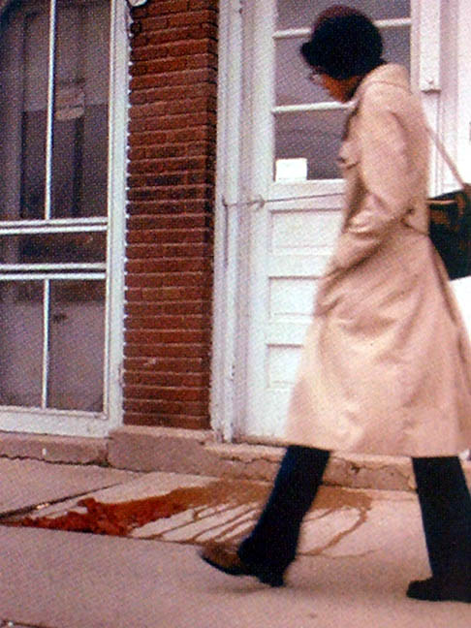
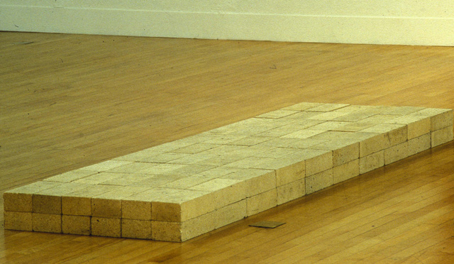
Ana Mendieta, Untitled
(People Looking at Blood), 1973
Carl Andre, Equivalent VIII, 1966

Slide 30
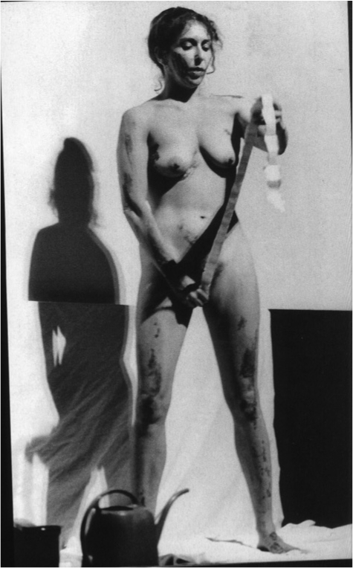
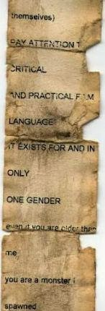
Carolee Schneeman, Interior Scroll, for Women Here and Now, an exhibition of paintings accompanied by a series of performances, East Hampton, New York, August 1975

Slide 31
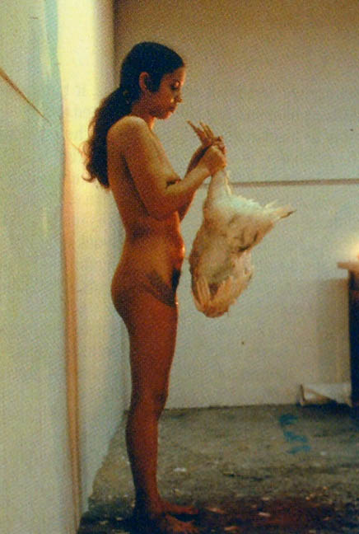
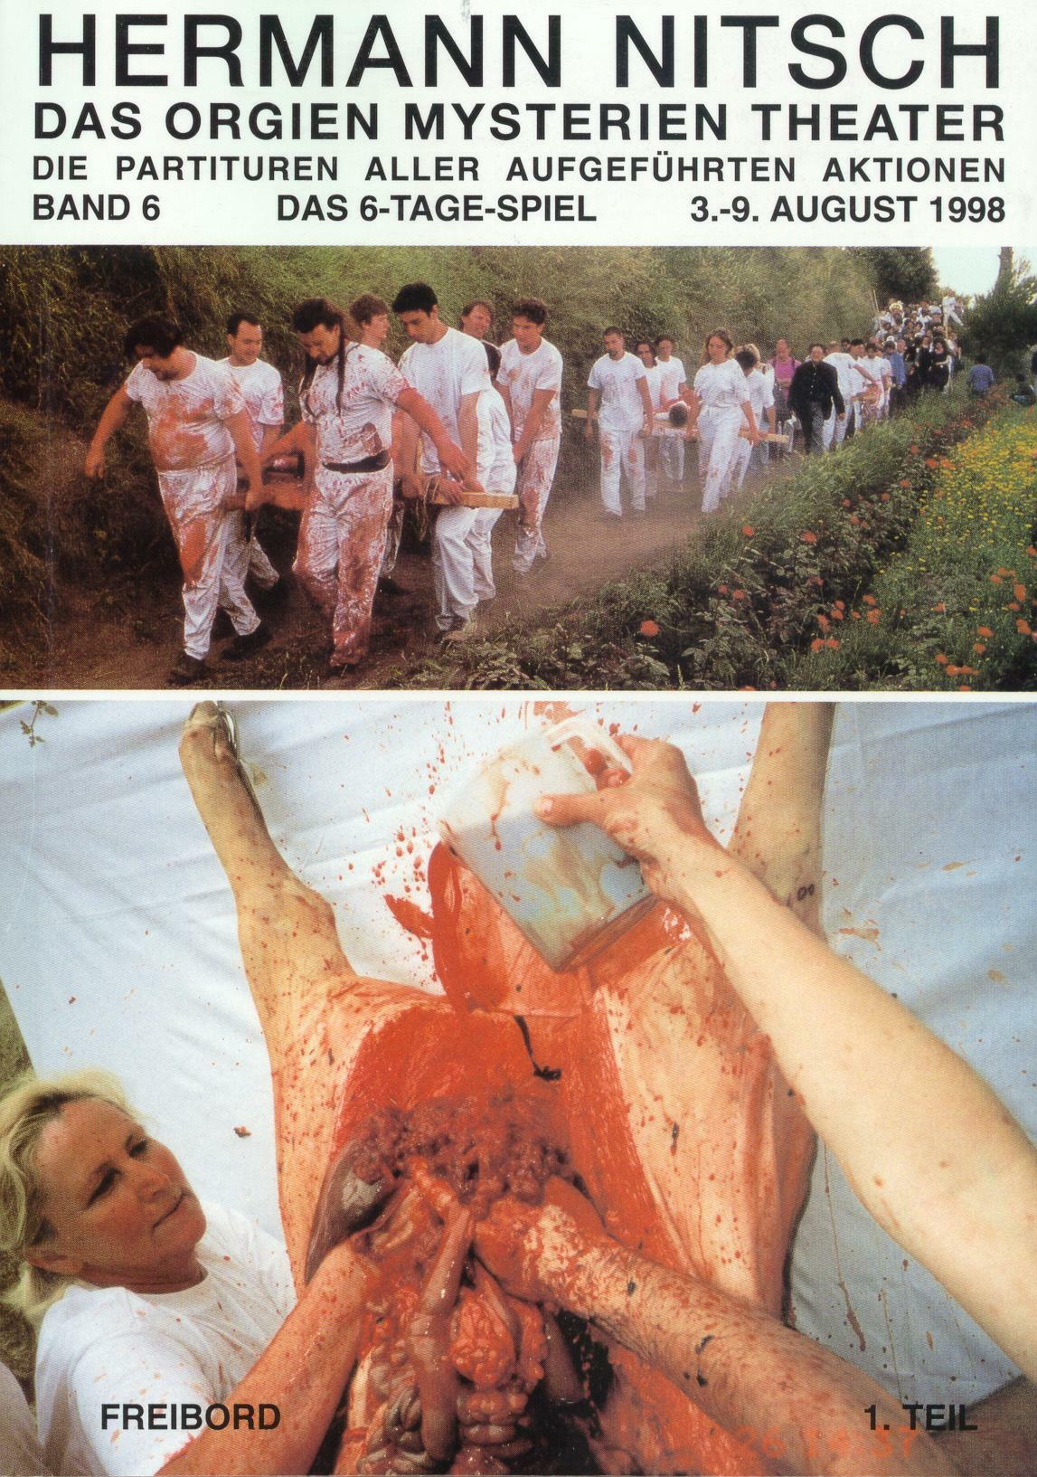
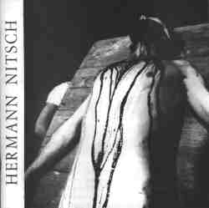
(left) Ana Mendieta, Untitled (Death of a Chicken), 1972 compare (center and left) Hermann Nitsch, Viennese Actionism, First Action, 1962

Slide 32
Ana Mendieta, Untitled (Body Tracks), 1975

Slide 33
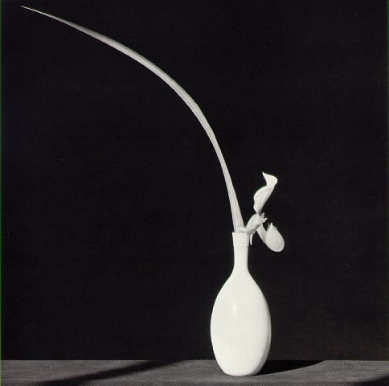
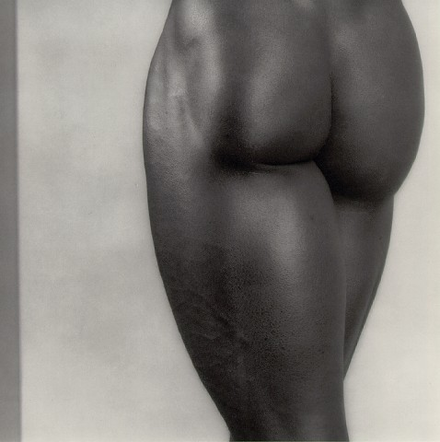
Robert Mapplethorpe, (left) Orchid in White Vase, 1982; and (right) Derrick Cross, 1982. Is there such a thing as “Gay” aesthetics?

Slide 34
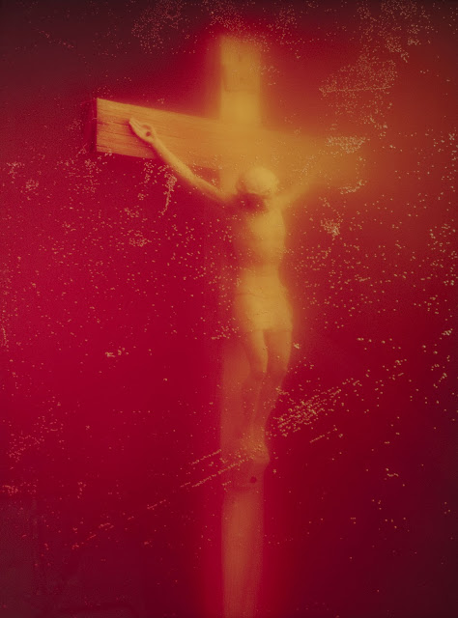
Andreas Serrano (US, b. 1950), Piss Christ, 1987, cibachrome print, edition of 10, 40 X 30 inches, photograph of a crucifix submerged in a glass container of the artist's urine

